Slide 1


By Veronicah Macharia
Data analyst
SOCIAL BUZZ:BRIDGING BIG DATA AND GROWING COMPANIES

Slide 2


Today's agenda
Project recap
Problem
The Analytics team
Process
Insights
Summary

Slide 3

Social Buzz ,a fast growing technology unicorn needs to adapt quickly to its global scale.
The project entails these three tasks:
1.An audit of Social Buzz’s big data practice
2.Recommendations for a successful IPO
3.An analysis to find Social Buzz's top 5 most popular categories of content
Project Recap

Slide 4
Problem
over 100000 posts per day
36,500,000 pieces of content per year!
How should they capitalize ion it when there is so much data?

Slide 5


Andrew Fleming
Chief Technical Architect
The Analytics team
Marcus Rompton
Senior Principle
Veronicah
Macharia
Data analyst

Slide 6
Process
1
Data Preparation
2
Data Cleaning
3
Data Modelling
4
Data analysis
5
Uncovering Insights &Reporting

Slide 7

Insights
1897
REACTIONS TO “ANIMAL POSTS’
JANUARY
MONTH WITH MOST POSTS
16
UNIQUE CATEGORIES

Slide 8
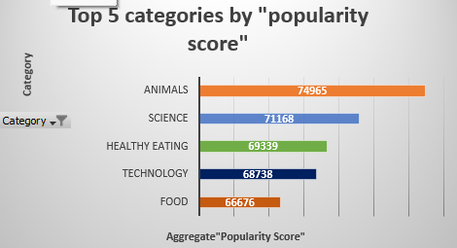
Top 5 preforming categories were animals, healthy eating, technology, science and food

Slide 9
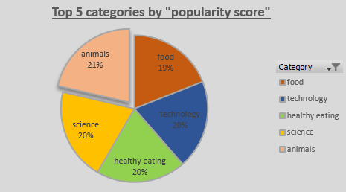

Slide 10

ANALYSIS
Animals and Science are the two most popular categories of your content, showing that people enjoy “factual” and “real-life” content the most.
INSIGHT
Food is a common theme with the top 5 categories with “healthy eating "ranking the highest. This may give an indication to the audience within your user base. You should use this insight to make a campaign and work with healthy eating brands to boost user engagement.
Summary

Slide 11
Thank you!
ANY QUESTIONS?

